Slide 1

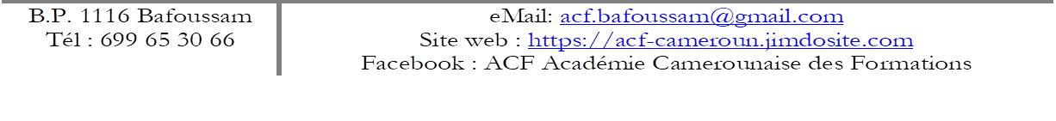
WELCOME TO
in Bafoussam

Slide 2
ACADEMIE CAMEROUNAISE DES FORMATIONS
A Civil Society Organisation in Bafoussam
Dr Michel FOALENG
Expert in Training Engineering
Executive Secretary of ACF

Slide 3
WHO WE ARE
a Cameroonian Civil Society Organisation (CSO) legalized in Bafoussam, since 2018: non-profit organisation
a team of trainers, teachers and social workers, as well as other facilitators with various experiences
a team committed to humanitarian and quality educational actions

Slide 4
WHERE WE ARE FROM
So many schools, Secondary and Higher Education, with so less external efficiency
So few training/education opportunities for the youth out of school
Merely education opportunities for adults
So many people, young and adults, looking for jobs, thus no qualification
People mostly unable to stand for themselves, and always waiting for whatever

Slide 5
OUR VISION
A society with individuals, adults and young people, responsible for their living conditions and the future of their community

Slide 6
OUR MISSION
to promote quality and inclusive education for all, especially the for vulnerable, in the perspective of peacebuilding, global citizenship, sustainable development and cultural diversity

Slide 7
WHERE WE ARE NOW
Since 2019, supporting IDPs from the Anglophone crisis in Bafoussam
Support for displaced children to access formal inclusive quality education
Collaboration with schools as support to IDPs students
Giving young out-of-school a chance for learning a trade
Supporting the socio-economic resilience of displaced families

Slide 8
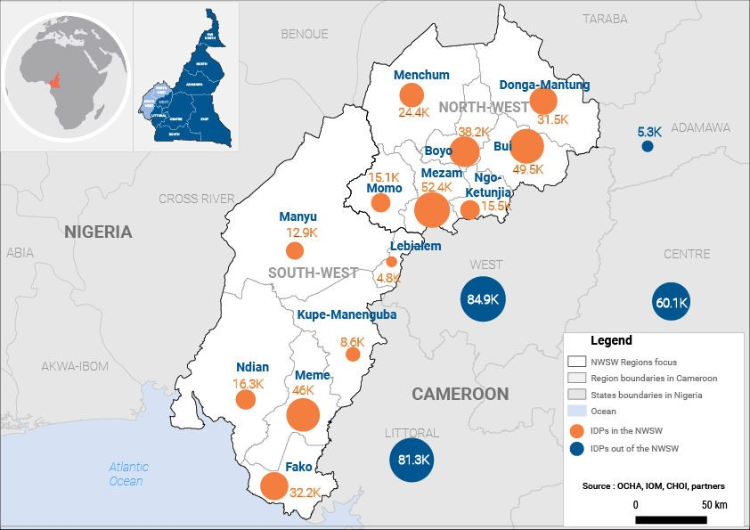
WHERE ARE THE IDP FROM

Slide 9
HOW MANY ARE THE IDP
As by the last MSNA/OCHA (sept.2022)
NW: 231.281 IDP
SW: 137.464 IDP
LT: 79.954 IDP
West Region: 114.111 IDP
Our visitors (Jan. - Sept.2022)
New persons : ca. 300 persons
Usually Visitors : 629 persons

Slide 10
WHO ARE THEY/HOW LONG

Slide 11
WHATFOR ARE THEY COMING TO US
Expressed Needs
Education (fees, material, etc.)
Health (bills, orientation, etc)
Rent (housing conditions…)
IGA/Job opportunity…
Nutrition
GBV (abandoned, abused, etc…)
Main need: Psycho-social support!!!
Couselling
Trauma Healing

Slide 12
Our Interventions
Formal Education
Informal Learning
Adults Education
Trainings
Humanitarian Actions

Slide 13
OUR MAIN SUPPORT FOR THE YOUTH
Supporting displaced children to access formal inclusive quality education
payment of school and examination fees
donation of learning materials, sports and attendance uniforms
psycho-social support and non-violent education
Psycho-pedagogical support (refresher courses, catsh-up classes, etc.)
Ca. 800 IDPs students supported since 2019

Slide 14
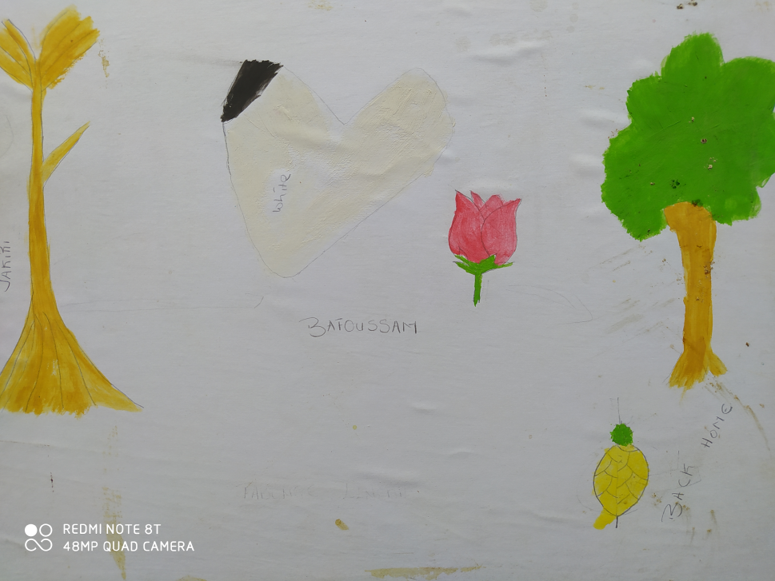
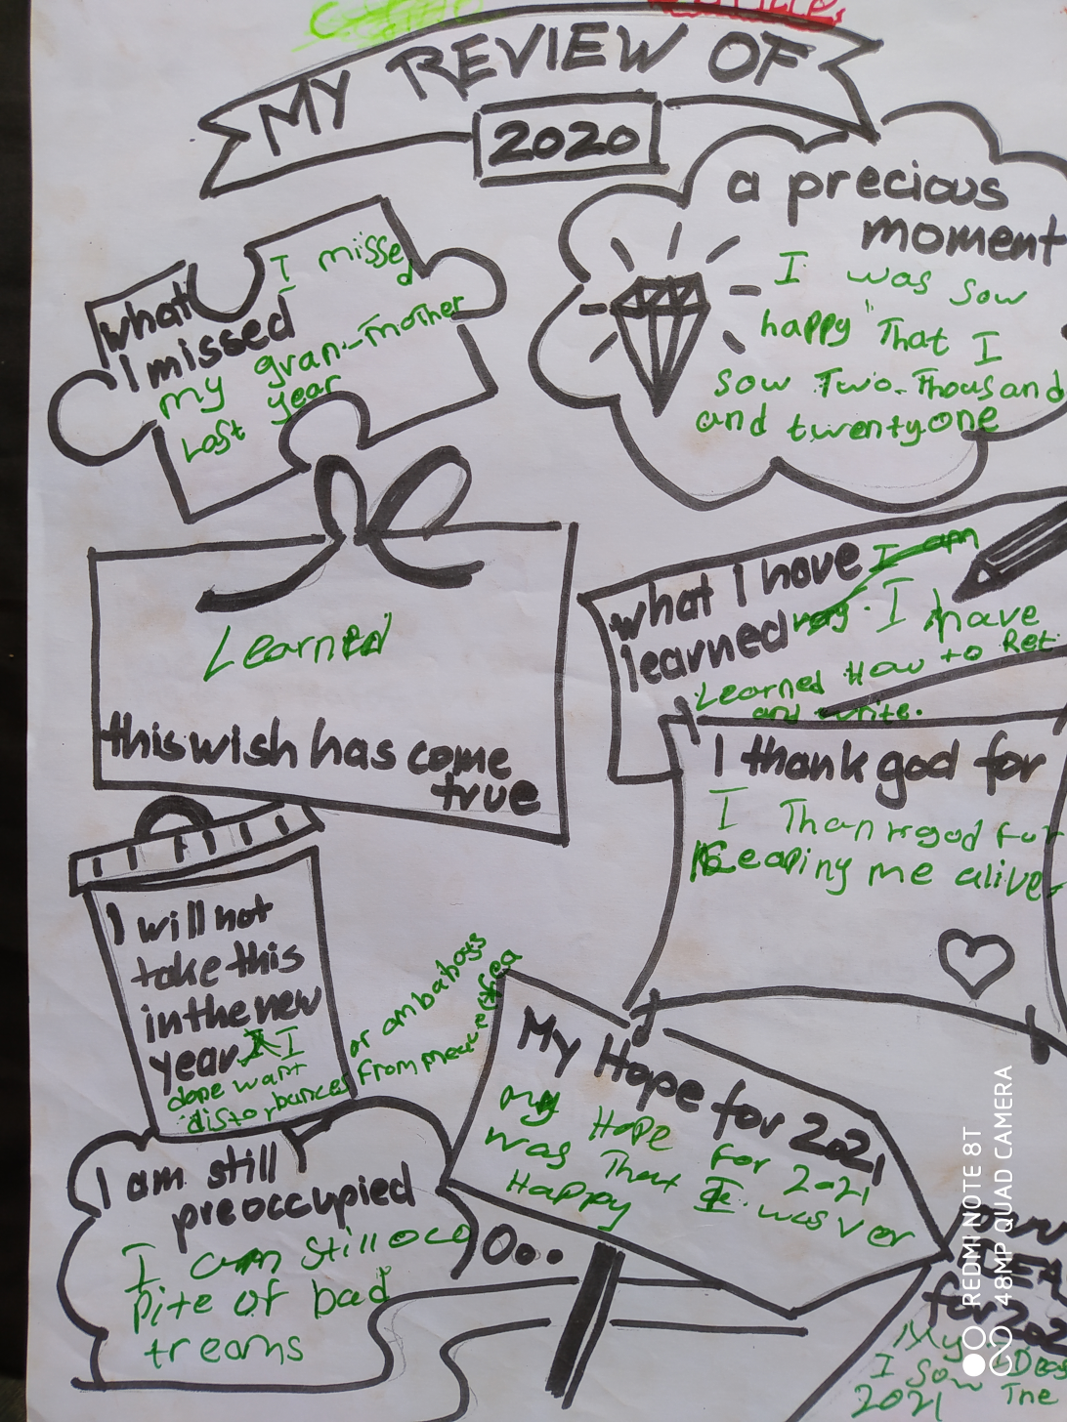
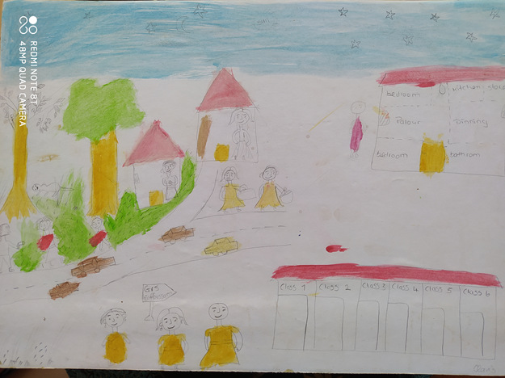

Slide 15
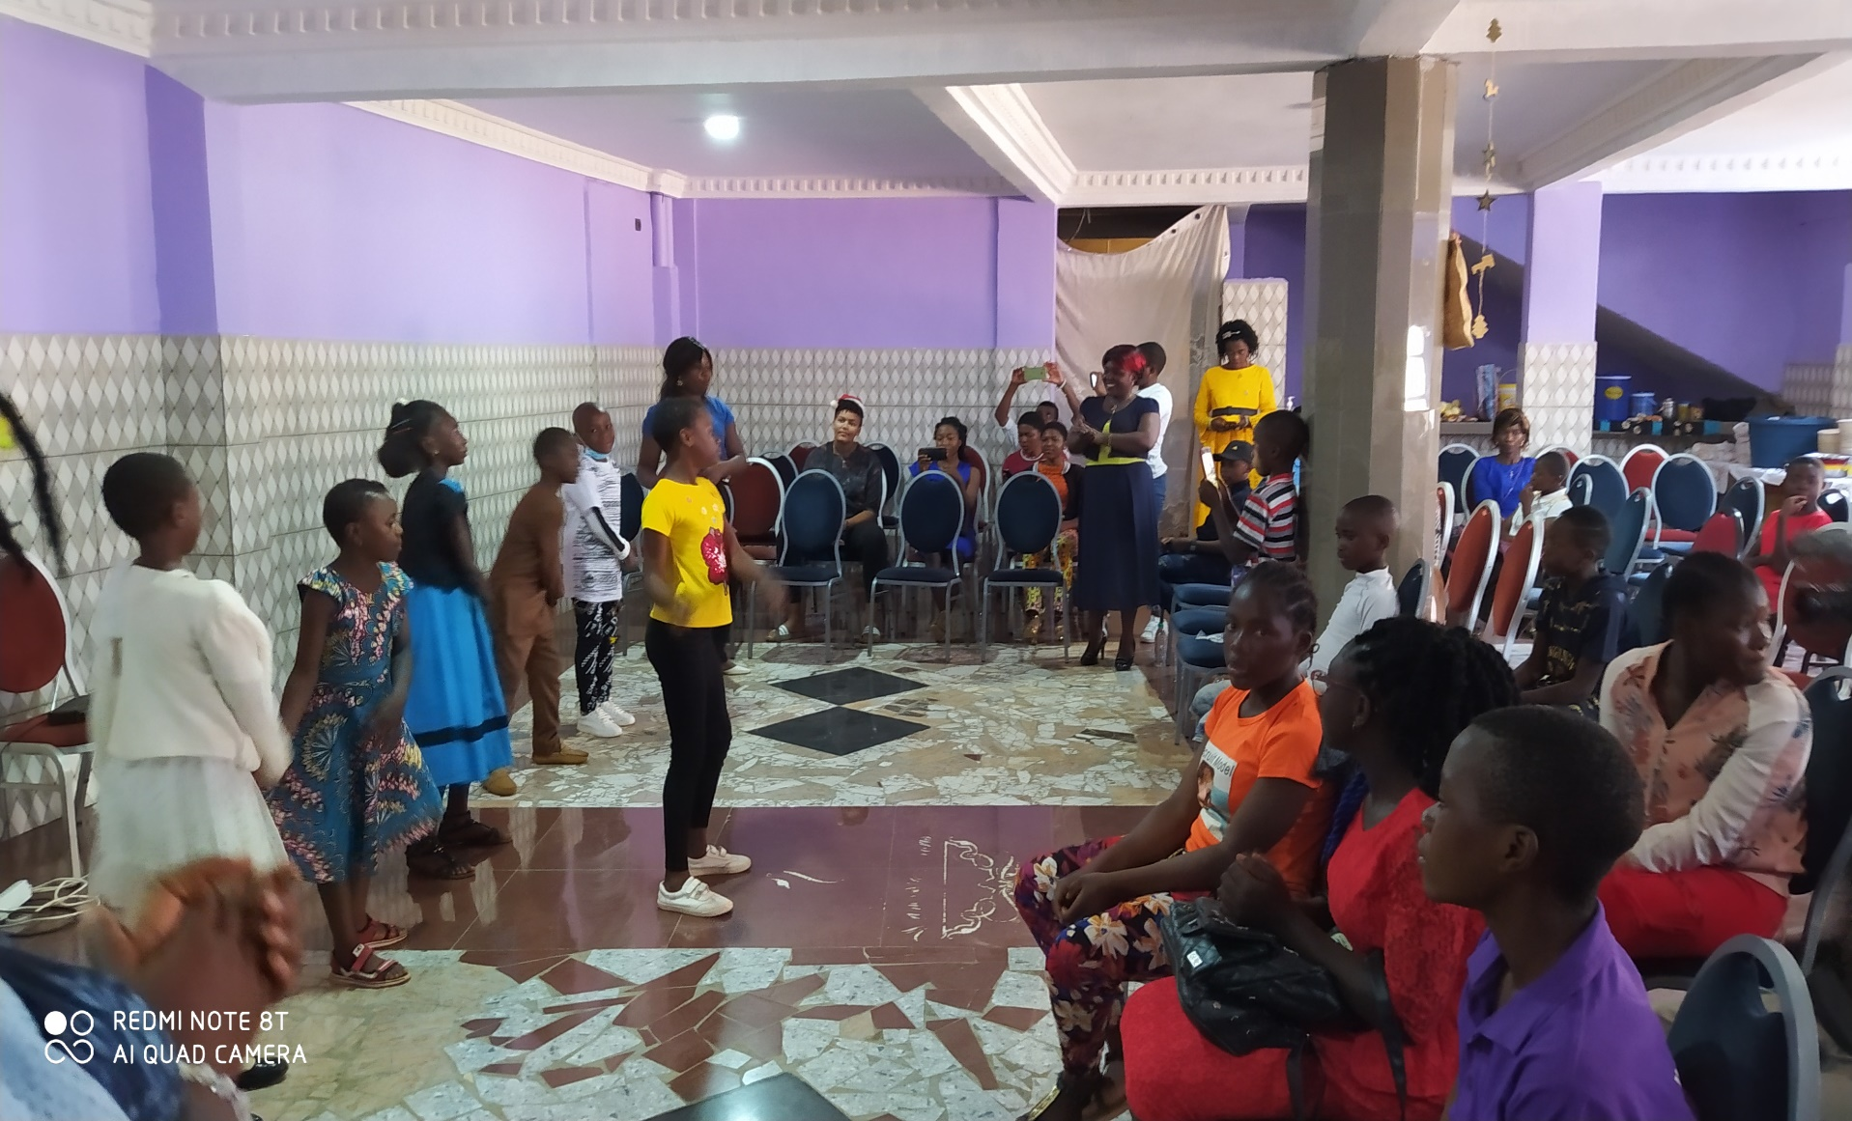

Slide 16
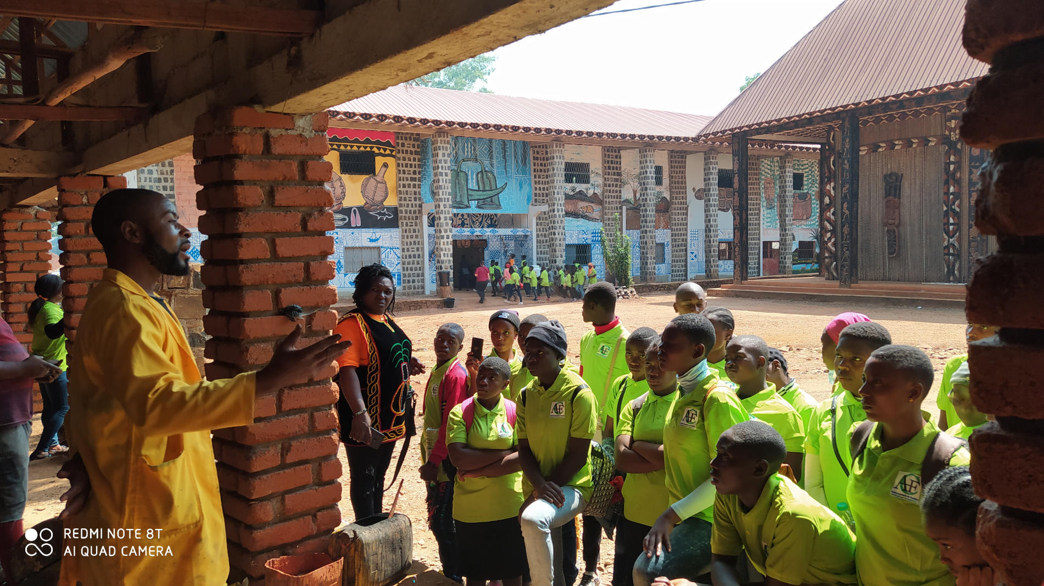

Slide 17
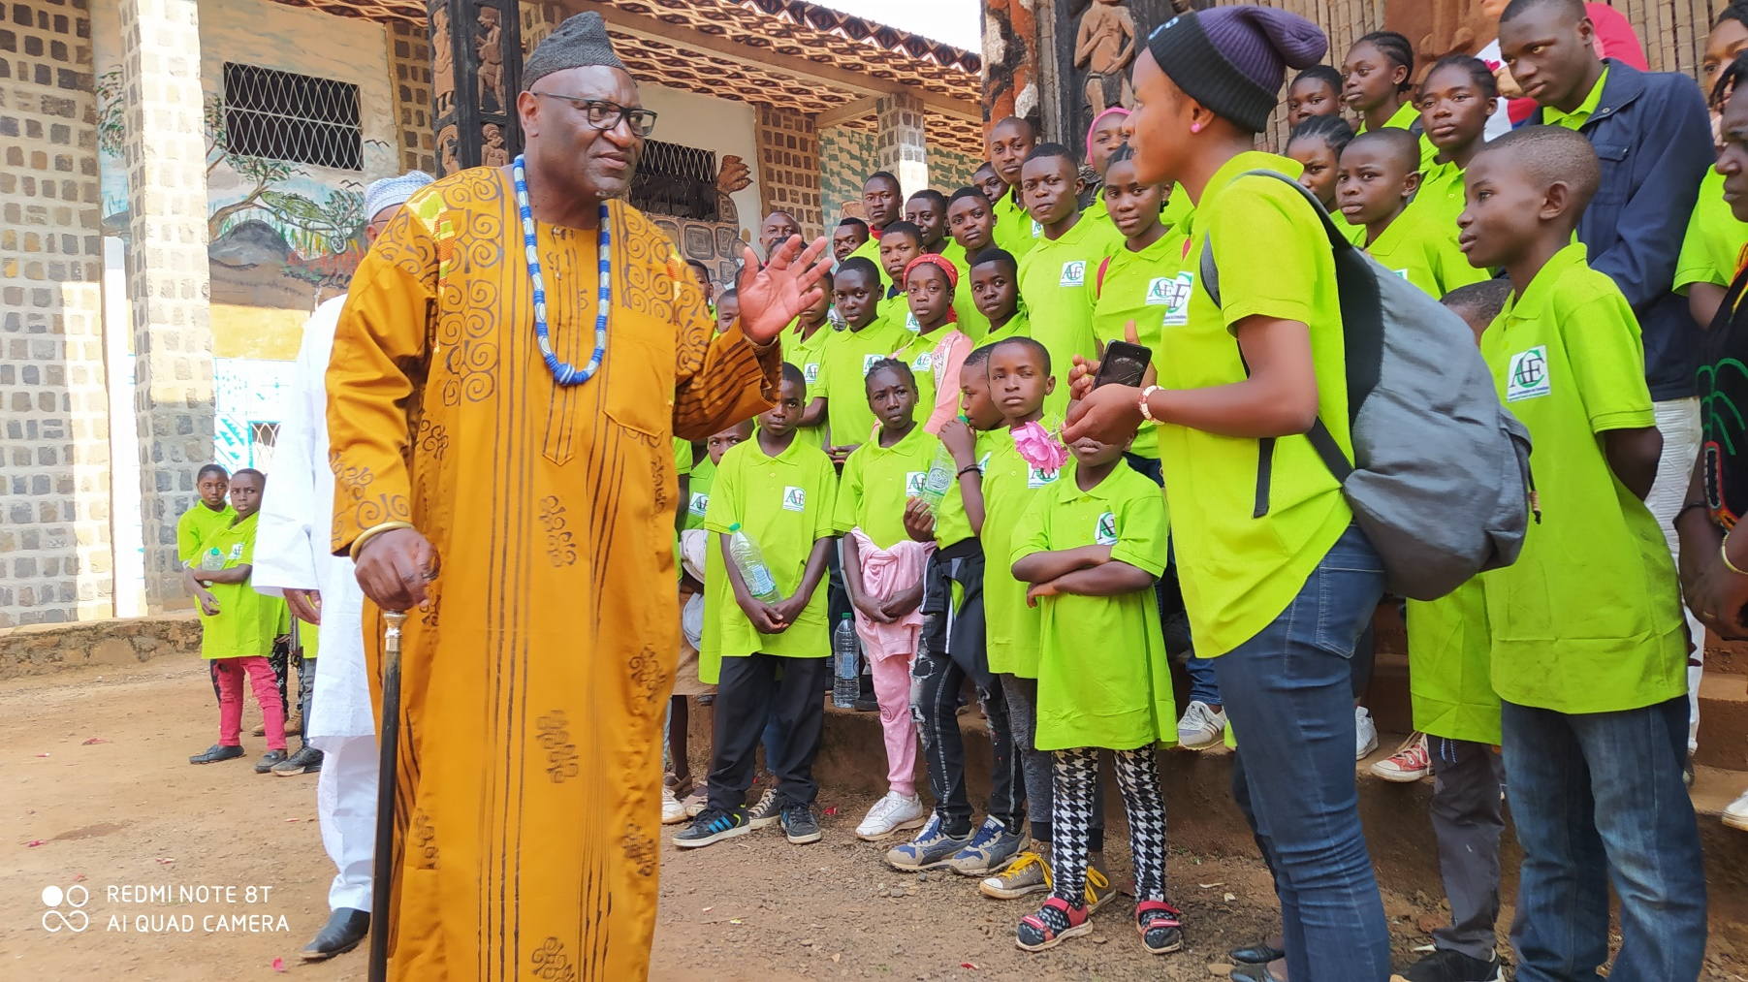

Slide 18
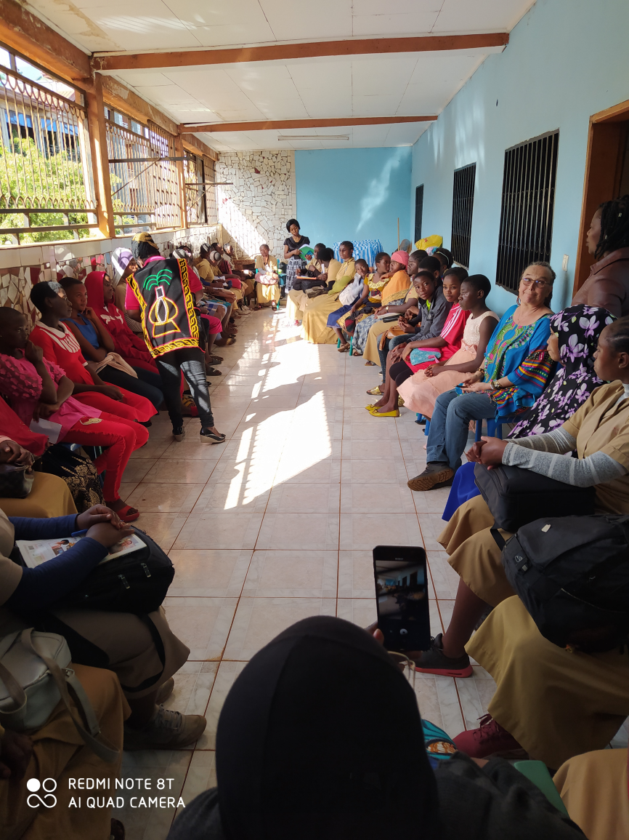

Slide 19
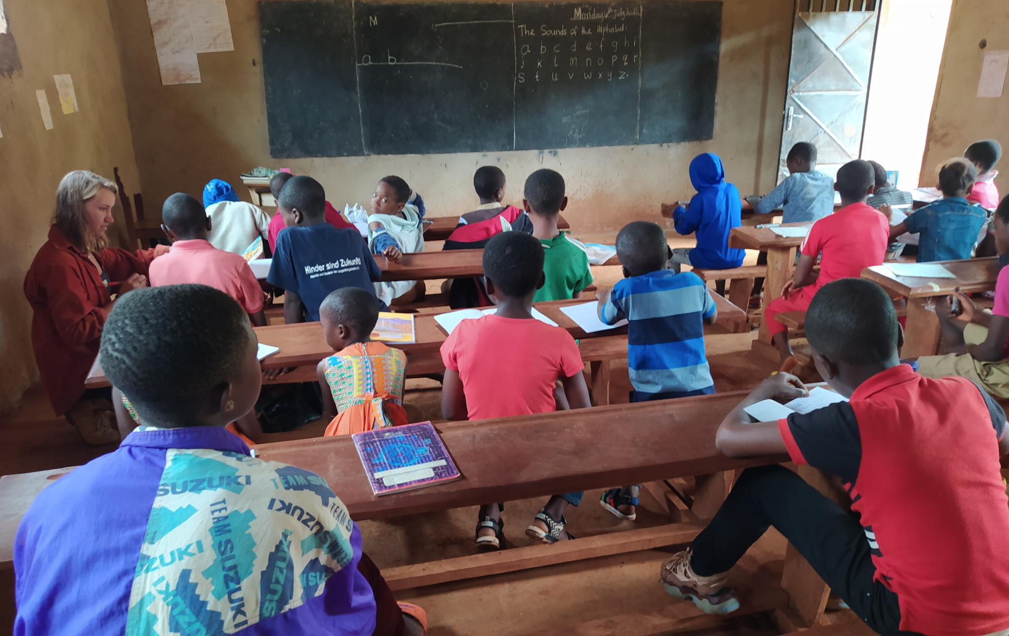

Slide 20
OUR MAIN SUPPORT FOR THE YOUTH
Giving young out-of-school a chance for learning a trade
Counselling and guiding them
Placing them in a workshop
Giving financial support

Slide 21
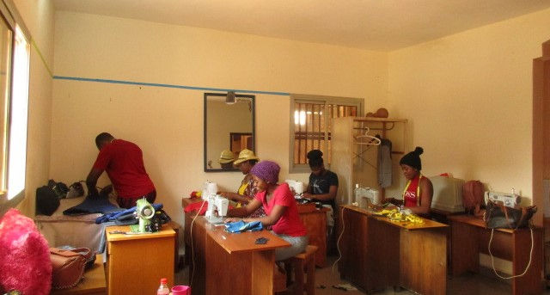
BRIDGE: Tailoring Worshop as a Training Centre

Slide 22
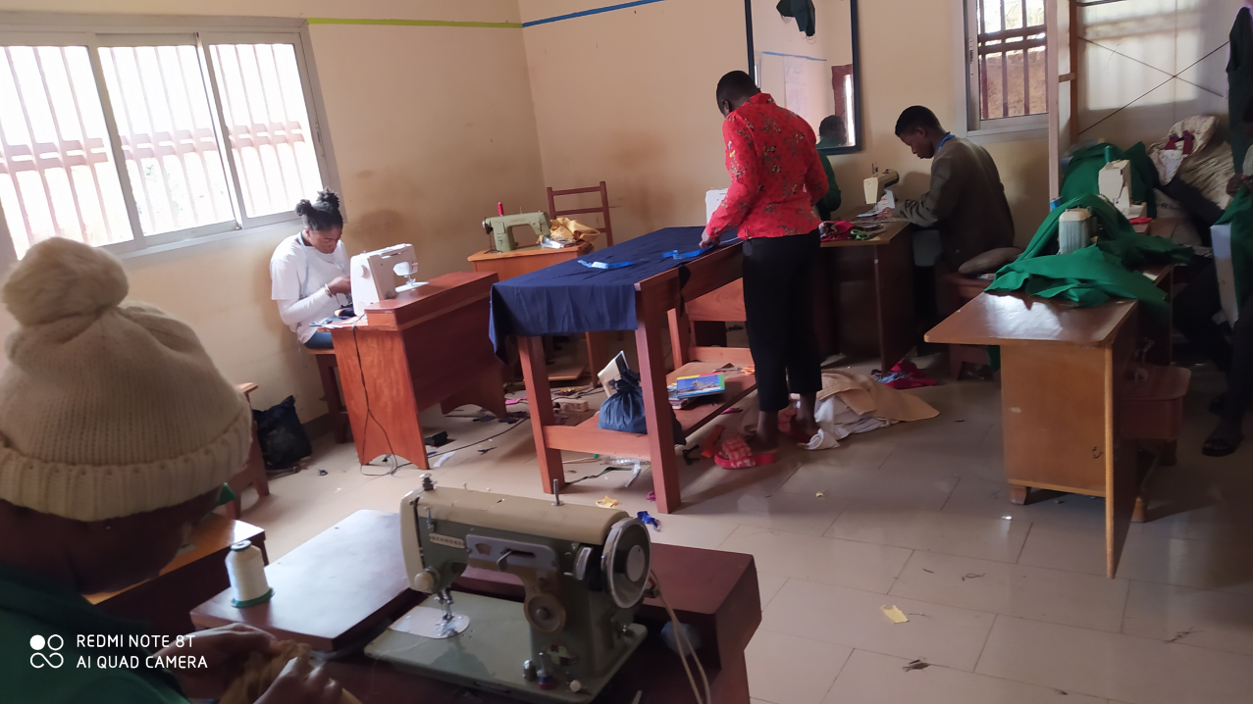
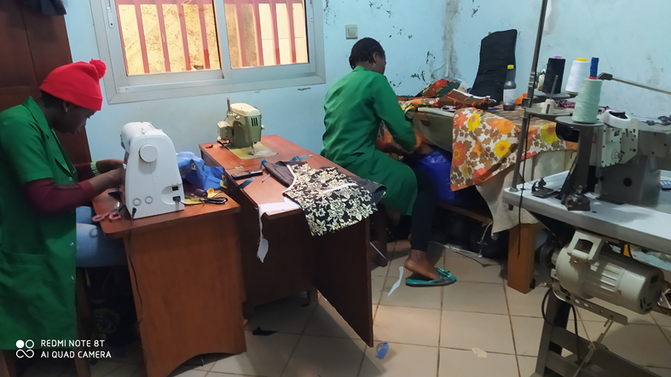
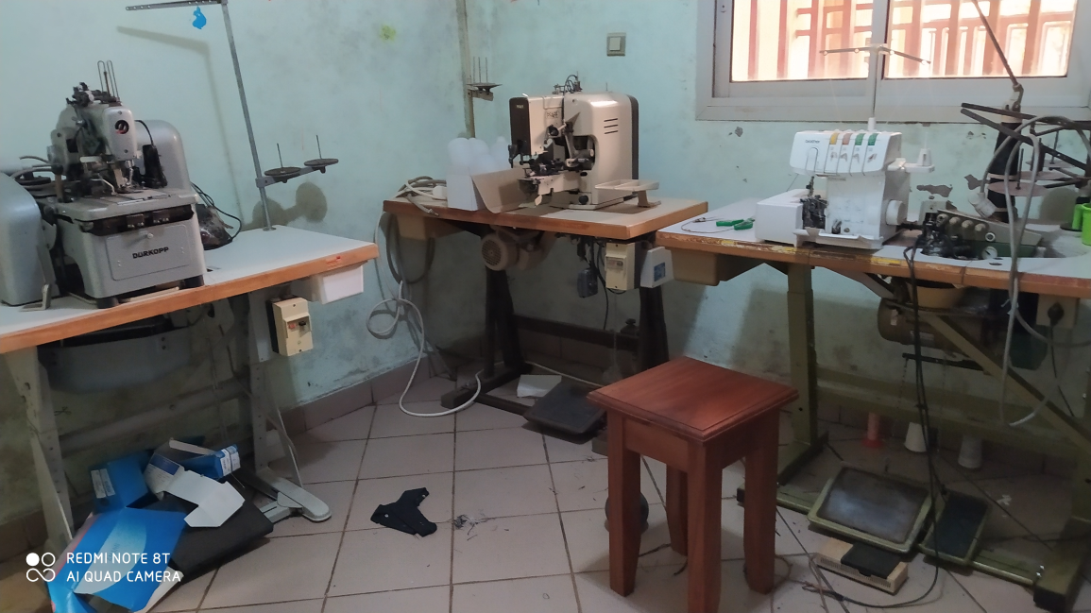

Slide 23
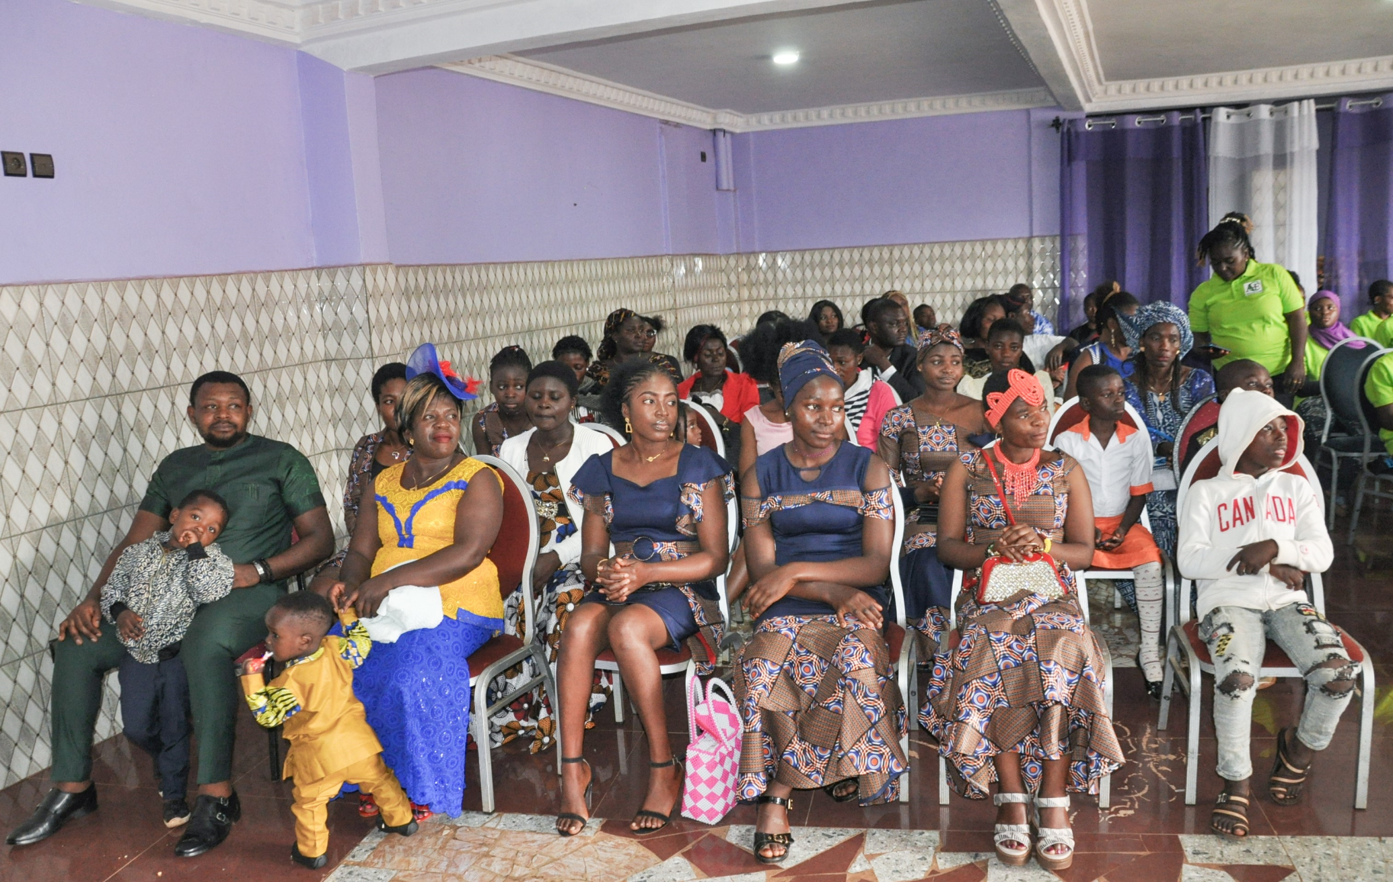

Slide 24
OUR MAIN SUPPORT FOR PARENTS
Supporting the socio-economic resilience of displaced families
psychosocial support (counselling, trauma healing)
Donation of various material (food, clothes, etc, …)
Financing IGAs and support in their implementation
Health education and support
support for vocational training
setting up of solidarity groups
Ca. 630 women, girls and young men supported since Jan. 2022

Slide 25
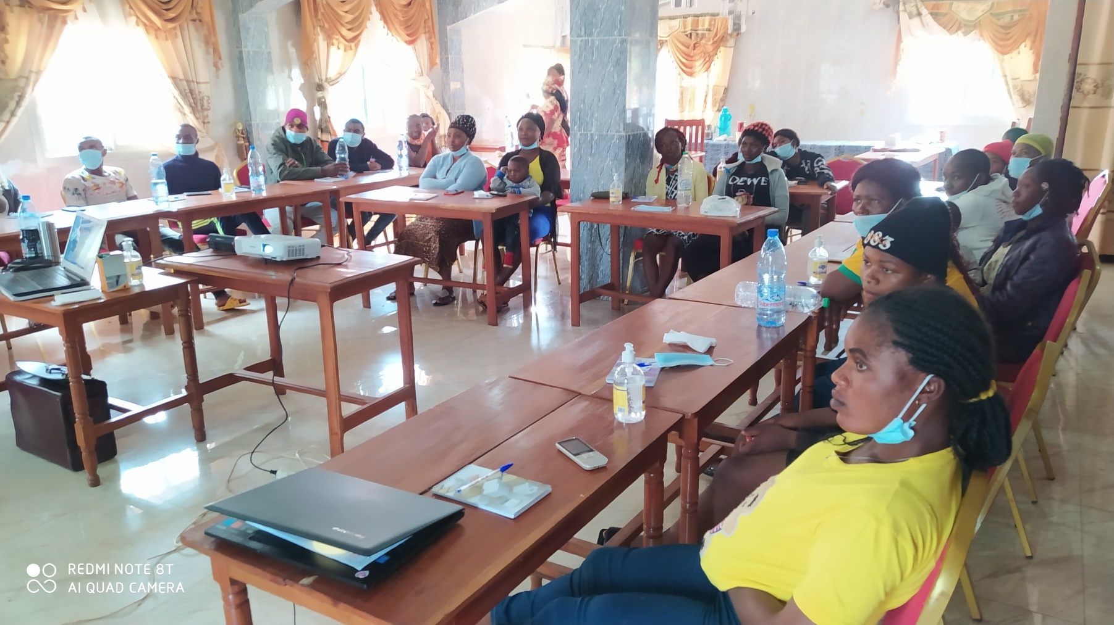

Slide 26
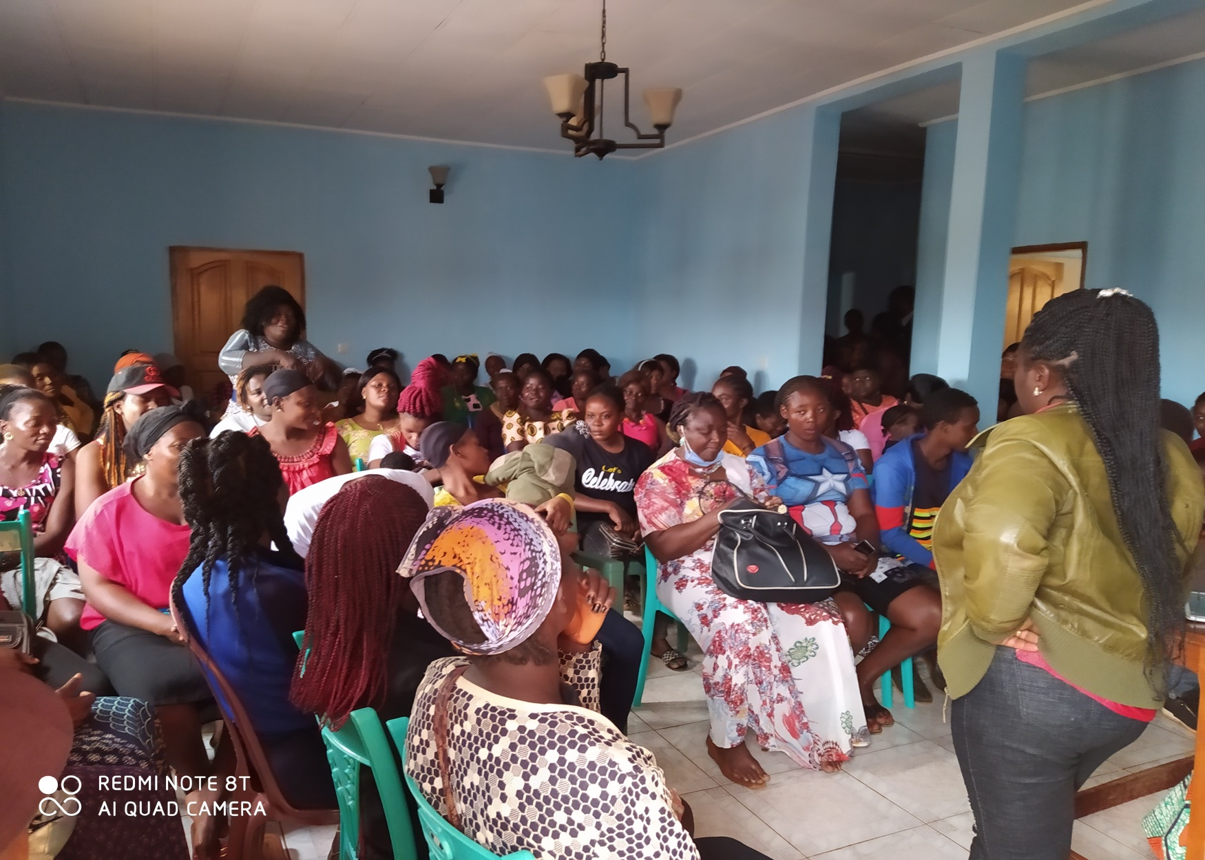

Slide 27
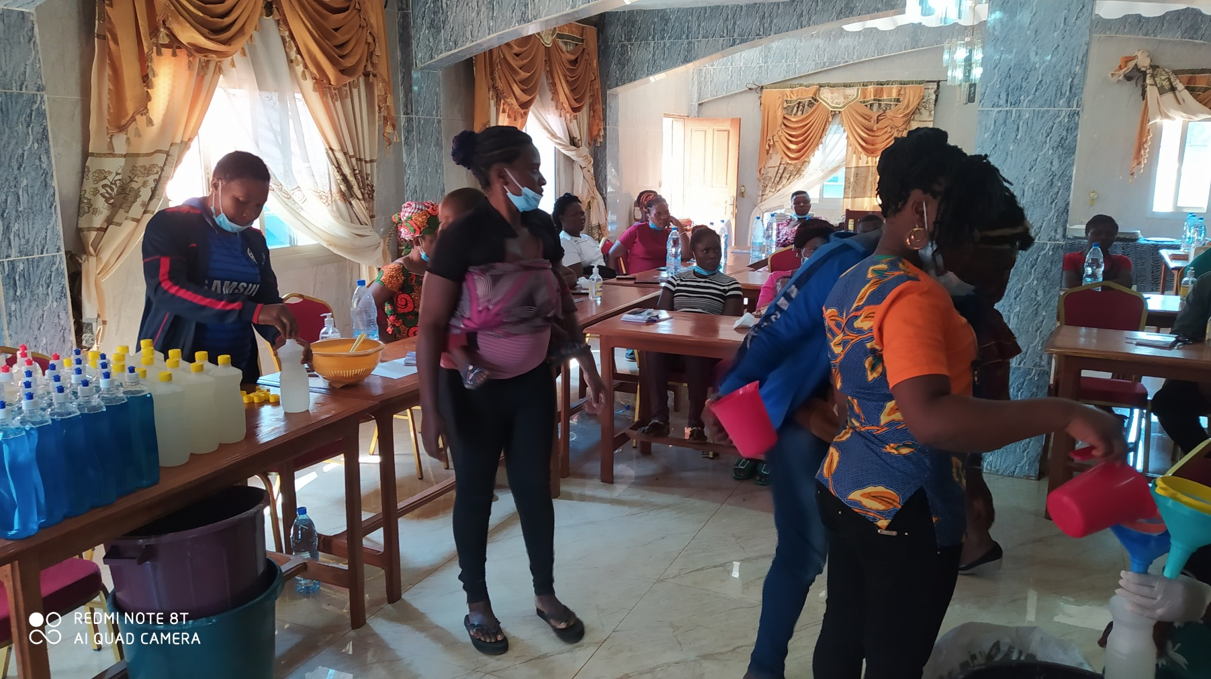

Slide 28
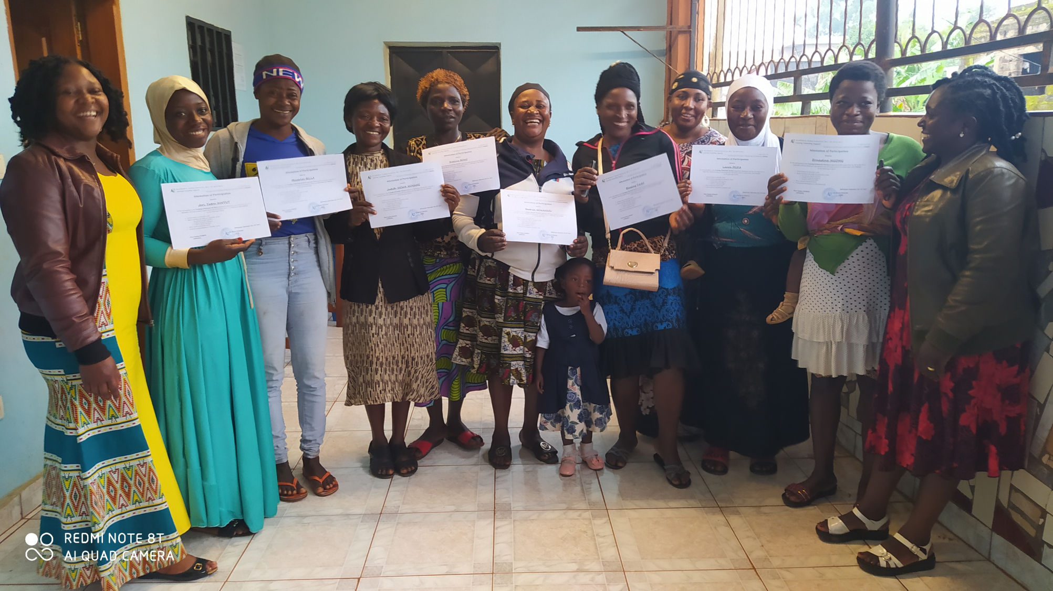

Slide 29
OUR MAIN SUPPORT FOR TEACHERS
Collaboration with schools‘ Staffs
Capacity building of teachers in psycho-social support
Capacity building for an Inclusive Education Approach
Various training courses

Slide 30
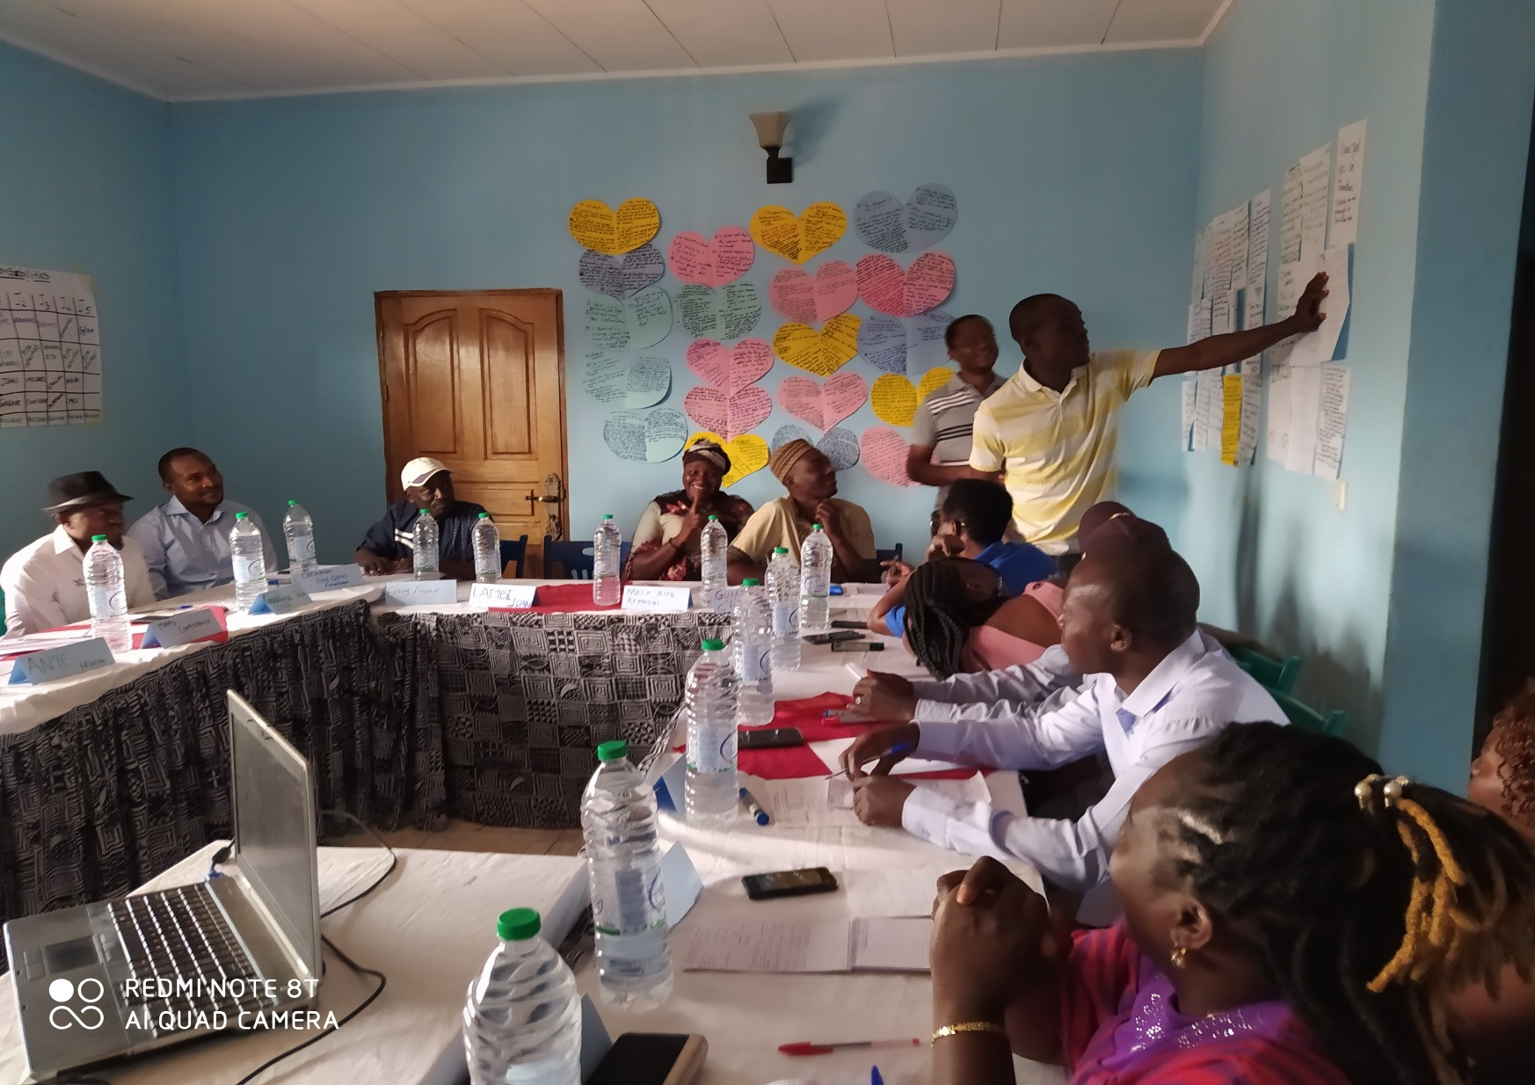

Slide 31
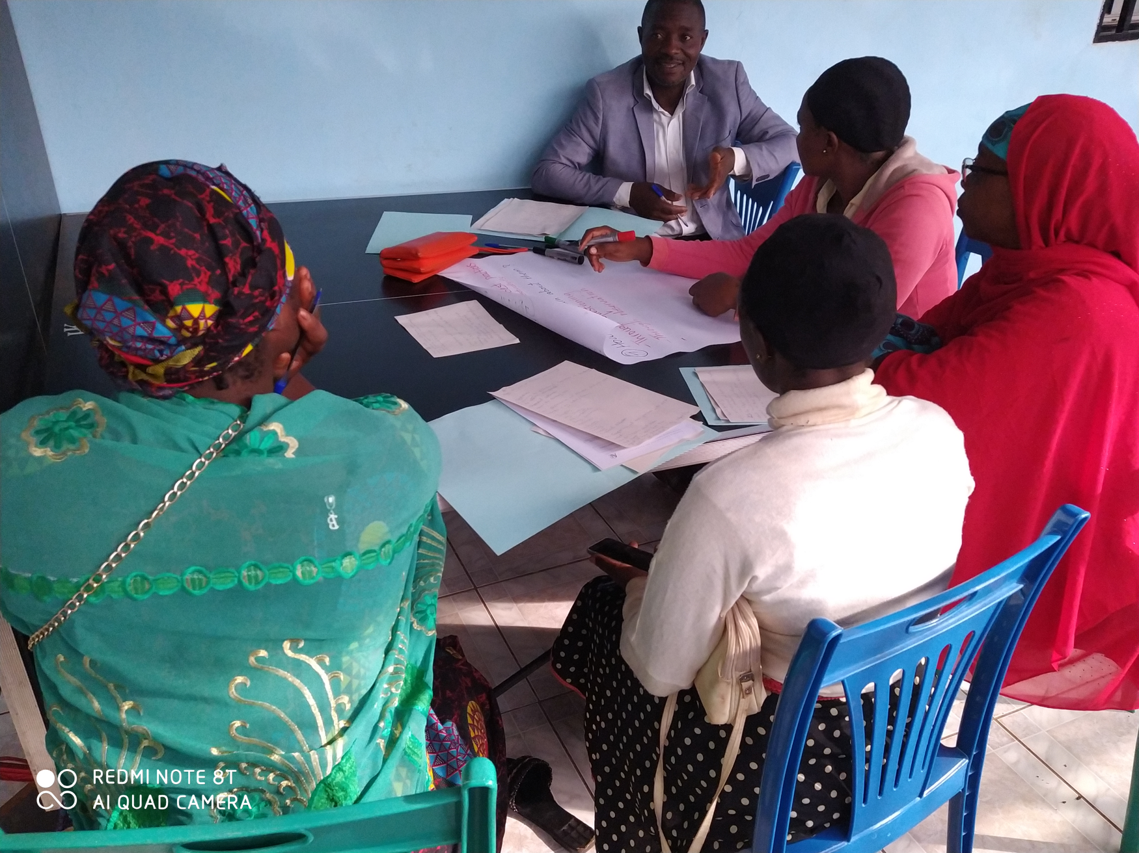

Slide 32
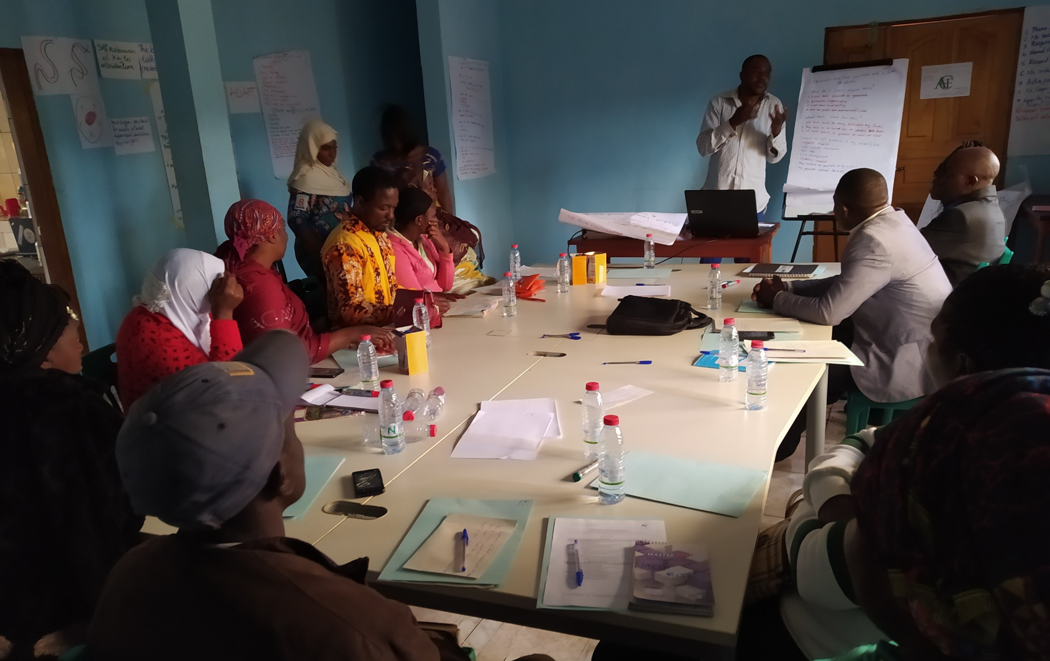

Slide 33
OUR STRATEGIES
based on transformative learning: giving young people and adults opportunity to question their facts, beliefs, values and attitudes
grounded on proximity, empathy and support: constantly starting from individual or collective diagnoses with the people concerned
cooperation of the beneficiaries is the vector of success for our actions in their favour
collaboration with other humanitarian organisations

Slide 34
OUR HUMAN RESOURCES
Operational staff made up of trainers, teachers and social workers with large experience
with contribution of:
teachers for holiday and evening classes
health professionals for health issues (health education, health campaigns and family planning…)
psychologists for psychotherapeutic care
many artists (dance, painting, sport, music, etc.)

Slide 35
OUR INCOMES
Thanks to the support of many benefactors
We started with Bon Secours, Basel Mission German Branch
Continue with Bon Secours, Mission 21
Some financial donars, with little amounts
Few local compagnies with material support (yoghurt, milk, beignets…transportation…)
Many other donars: clothes, mattrasses, foodstuffs…
Transparency and accountability in managing the donations

Slide 36
OUR CHALLENGES
Facing increasing demand
More and more IDP, due to persisting crisis
People who arrived for years are less and less able to stand for themselve: no job opportunities, more and more concurence in small businesses …
More and more children out-of-school for years
Facing our running charges
HOW TO SUBSTAIN OUR SUPPORT??!

Slide 37
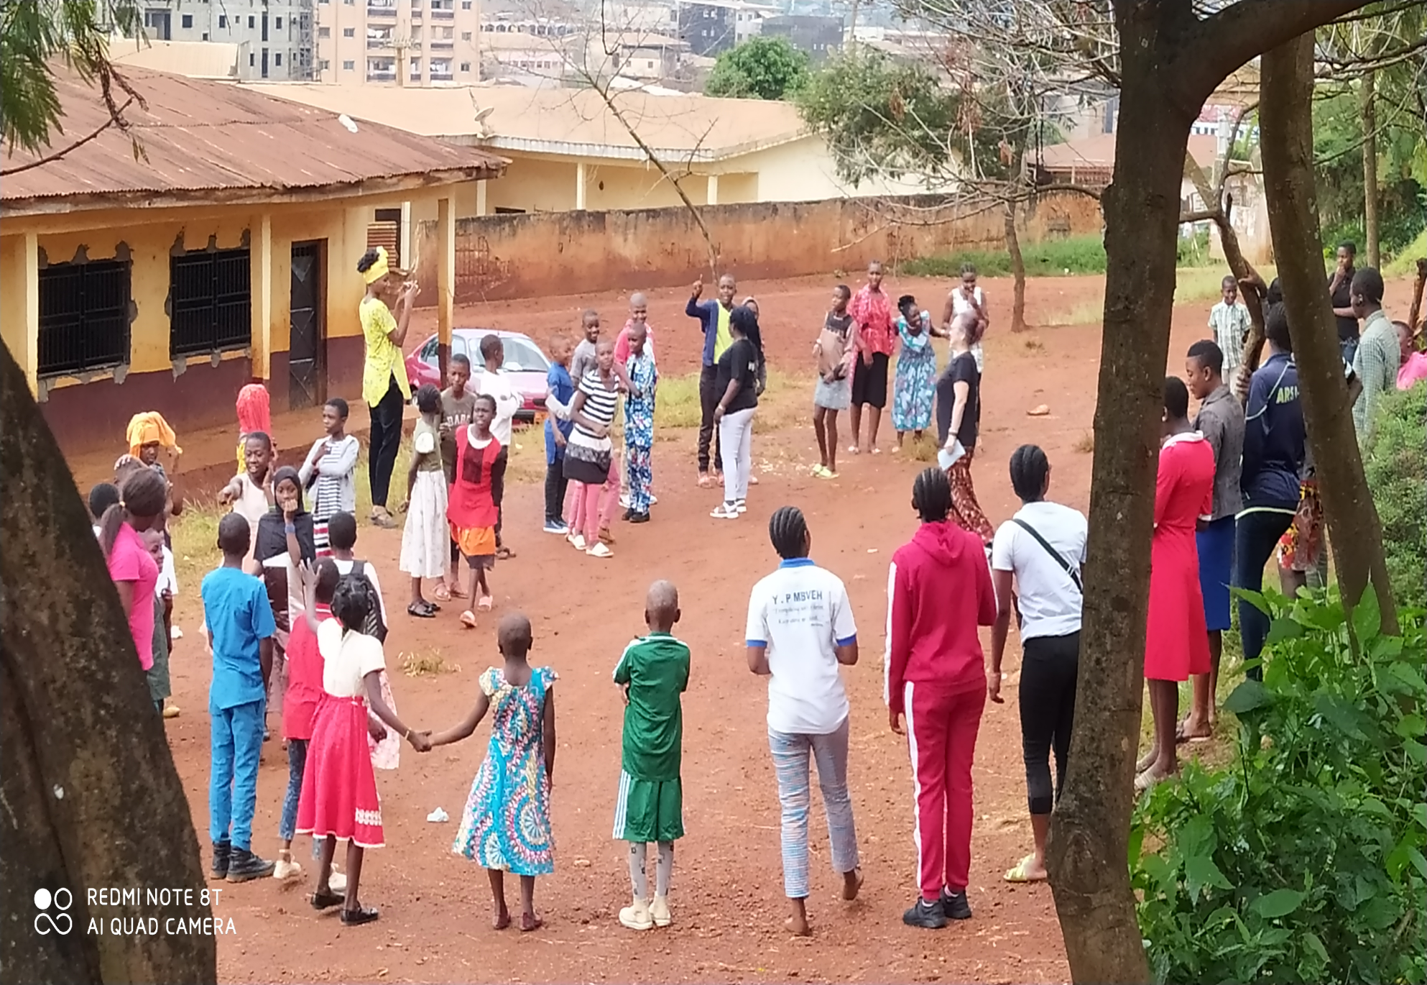
THANK YOU

